Slide 1


Slide 2
Blood Relation 1.1

Slide 3

Types of Blood Relation Questions
Third person reference type
Solving relation mystery type
Secretive deduction type
Coded relation type
Puzzle type

Slide 4
BLOOD RELATIVES
COUPLE
COUPLE
GRAND FATHER (+)
GRAND MOTHER (-)
GRAND FATHER (+)
GRAND MOTHER (-)
SIBLING
COUPLE
SIBLING
UNCLE (+) / AUNT (-)
FATHER (+)
MOTHER (-)
UNCLE (+) / AUNT (-)
SON
DAUGHTER
SON
DAUGHTER
(PATERNAL)
(MATERNAL)
COUSIN (+) / (-)
COUSIN (+) / (-)
SIBLING
YOU
BROTHER (+) / SISTER (-) -
DAUGHTER
SON
NIECE (-)
NEPHEW (+)

Slide 5
Third person reference type
Pointing to a lady in a photograph, Meera said, “Her father’s only son’s wife is my mother-in -law”. How is Meera’s husband related to that lady in the photo?
Explanation
(a) Nephew
Father +
(b) Uncle
(c) Son
Photo lady -
Son +
Wife -
(d) Father
(e) None of the above
Meera’s Husband +
Meera -
ANS :
ANS : Nephew

Slide 6
Third person reference type
Pointing to a photograph Vikas said “She is the daughter of my grandfather’s only son”. How is the person in the Photograph related to Vikas?
Explanation
(a) Father
Father +
(b)Sister
(c) Brother
Son +
(d) Uncle
(e) None of the above
Vikas +
Photo lady -
ANS :
ANS : sister

Slide 7
Third person reference type
Looking at a photograph a person said “I have no brother or sister but that man’s father is my father’s son”. At whose photograph was the person looking at ?
Explanation
(a) His son’s
Person’s Father +
(b) His nephew
(c) His father’s
That that photograph indicating person +
Father of Man in photo +
(d) His own
(e) None of the above
Man in photo+
ANS :
ANS : His son’s

Slide 8

Solving relation mystery type
Tarun is the father of Rohit. Rohit is the brother of Kala. Kala is the wife of Dilip. How is Dilip related to Rohit?
Explanation
(a) Brother-in-law
Tarun +
(b) Father-in-law
(c) Son
Rohit
Kala -
Dilip +
(d) Uncle
(d) None of the above
ANS :
ANS : Brother-in-law

Slide 9
Solving relation mystery type
Kusuma is the wife of Ravi. Govind and Prabhu are brothers. Govind is the brother of Ravi. Prabhu is Kusuma’s
Explanation
(a) Cousin
(b) Brother
Ravi is brother of Govind and Prabhu.
Prabhu is Brother-in-law of Kusuma.
(c) Brother-in-law
(d) Uncle
(d) None of the above
ANS :
ANS : Brother-in-law

Slide 10
Solving relation mystery type
Seema is the daughter-in-law of Sudhir and sister -in-law of Ramesh. Mohan is the son of Sudhir and only brother of Ramesh. Find the relation between
Seema and Mohan.
Explanation
(a) Sister-in-law
Seema is the daughter-in-law of Sudhir
Mohan is the son of Sudhir. Seema is the sister-in-law of Mohan's only brother Ramesh.
Therefore, Seema is the wife of Mohan
(b) Aunt
(c) Cousin
(d) Wife
(d) None of the above
ANS :
ANS : Wife

Slide 11
Secretive deduction type
How is my brother’s grandfather’s only son’s only child related to me?
Explanation
(a) Sister-in-law
Grand Father +
(b) Sister
(c) Cousin
Mother -
Uncle +
(d) Nephew
(d) None of the above
Brother +
Cousin +
Me +
ANS :
ANS : Cousin

Slide 12
Secretive deduction type
Ravi’s father has a son Rohit who has an aunt Laxmi who has a husband Rao whose father-inlaw is Mohan. What is the relation of Mohan to Ravi ?
Explanation
(a) Nephew
Rao is uncle of Rohit and Ravi.
Therefore, Mohan is Grandfather of Ravi.
(b) Grandfather
(c) Son
(d) Uncle
(d) None of the above
ANS :
ANS : Grandfather

Slide 13
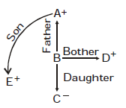
Secretive deduction type
A is the father of B, C is the daughter of B, D is the brother of B, E is the son of A. What is the relationship between C and E ? and
(4) Uncle and aunt
Explanation
(a) Brother and sister
(b) Cousins
(c) Niece and uncle
(d) Uncle and aunt
(e) None of the above
ANS :
ANS : Niece and uncle

Slide 14
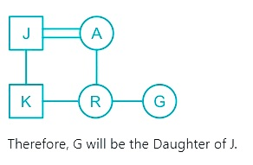
Coded relation type
‘T + M’ means ‘M is sister of T’, ‘T @ M’ means M is son of T’ and ‘T # M means ‘M is husband of T’. If A # J @ K + R + G, then how is G related to J?
Explanation
(a) Daughter
(b) Daughter in law
(c) Mother
(d) More than one of the above
(e) None of the above
ANS :
ANS : Daughter

Slide 15
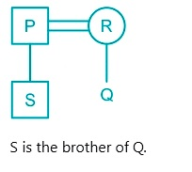
Coded relation type
If ‘A @ B’ means ‘A is the husband of B’, ‘A % B’ means ‘A is the mother of B’, and ‘A & B’ means ‘A is the son of B’, then how is S related to Q when ‘S & P @ R% Q’?
Explanation
(a) Cousin
(b) Brother
(c) Son
(d) More than one of the above
(e) None of the above
ANS :
ANS : Brother

Slide 16
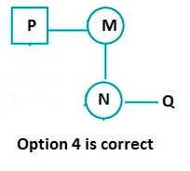
Coded relation type
If A + B means A is the mother of B; A - B means A is the brother of B; A % B means A is the father of B and A x B means A is the sister of B, which of the following shows that P is the maternal uncle of Q?
Explanation
(a) Q – N + M x P
(b) Q – S % P
(c) P + S x N - Q
(d) P – M + N x Q
(e) None of the above
ANS :
ANS : P – M + N x Q

Slide 17
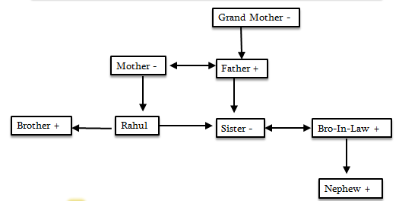
Secretive deduction type
Rahul went to his mother’s mother in law’s only son’s daughter’s husband’s son’s maternal uncle and asked for some money. How is the person related to Rahul?
Explanation
(a) Sister-in-law
(b) Brother-in-law
(c) Cousin
(d) Brother
(d) None of the above
ANS :
ANS : Brother

Slide 18
Puzzle type
A is the only son of Q who is the brother-in-law of Y. U is the mother of B but she is not the spouse of Q. Y is the unmarried brother of Z. X is the paternal aunt of B whereas V is the daughter-in-law of A. No single parent has a child and an equal number of males and females are there in the family.
1. How is X related to Y?
(a) Nephew (b) Niece (c) Son (d) Daughter (e) Cannot be determined
2. If J is the brother of V, then how is J related to B?
(a) Daughter-in-law (b) Son-in-law (c) Brother-in- law (e) None of these
3. Who among the following person is the mother of A?
(a) Z (b) U (c) X (d) Y (e) None of these

Slide 19
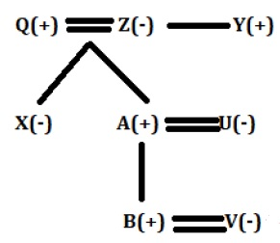
Explanation
ANS : Q1) Niece
ANS : Q2) Brother-in- law
ANS : Q3) Z

Slide 20
Get the answers.
Pointing to a man in a photograph a woman says ‘‘He is the father of my only daughter-inlaw's father-in-law." How is man related to woman?
(a) Father
(b) Brother
(c) Husband
(d) Father-in-law
2. Introducing a man to her husband a woman said "His brother's father is the only son of my grand father". How is the woman related to this man?
Mother
(b) Aunt
(c) Sister
(d) Daughter

Slide 21
Get the answers.
A is the brother of B, C is the father of D, E is the mother of B. A and D are brother. How is E related to C?
(a) Sister
(b) Sister-in-law
(c) Niece
(d) Wife
2. P is the brother of Q. R is the mother of Q, S is the father of R, T is the mother of S. How is P related to T?
(a) Grand-daughter
(b) Great grandson
(c) Grandson
(d) Grandmother

Slide 22
Get the answers.
‘P ÷ Q means ‘P is the son of Q’,
‘P - Q means ‘P is the husband of Q’,
‘p x Q’ means ‘P is the brother of Q’ and
‘P + Q means ‘P is the wife of Q’.
If J ÷ H + M ÷ S - F’, then how is F related to J?
(a) Mother
(b) Grandfather
(c) Grandson
(d) Grandmother

Slide 23
Puzzle type
P, Q, R, S, T, U are 6 members of a family in which there are two married couples. T, a teacher is married to a doctor who is mother of R and U. Q, the lawyer is
married to P - P has one son and one grandson. Of the two married ladies one is a house wife. There is also one student and one male engineer in the family. Which of the following is true about the grand-daughter of the family ?
(a) She is a lawyer
(b) She is an engineer
(c) She is a student
(d) She is a doctor
(e) None of the above

Slide 24

THANK YOU

